Slide 1

INT234 PREDICTIVE ANALYTICS
Lecture #0
The kick start session

Slide 2
Course Overview
Course Code : INT234
LTP – 2 0 2[Two Lectures and Two Practical's/week]
Credits – 3

Slide 3
Marks Breakup
Credits : 3
Marks Breakup:
* 2 Cas, CA1-30 marks and CA2(Project)- 100 marks
* No MTE
Activity | Marks
Attendance | 5
Continuous Assessment | 45
End-Term Practical (ETP) | 50
Total | 100

Slide 4
CA for this course
CA1 : BYOD PRACTICAL
Allotment/Submission week:5/6 week
3 scenario- based questions in fraction of 10 marks each.
CA2 : Skill Based Assessment
Allotment/Submission week:5/12 week
A) Problem Statement (Objectives) and Dataset (10 Marks)
1. Problem Statement (5 Marks)
2. Dataset (5 Marks)
B) Implementation (Outcome), Report, and Viva (60 Marks)
1. Implementation (30 Marks)
a) Data Cleaning and Visualization (5 Marks)
b) EDA and Statistical Analysis (10 Marks)
c) Model development and evaluation(15 Marks)

Slide 5
2. Report (10 Marks)
a) Format (5 Marks)
b) Technical Writing (5 Marks)
3. Viva (20 Marks)
C) LinkedIn Engagement (10 Marks)
1. Likes (6 Marks)
2. Comments (4 Marks)
D) GitHub Contributions (20 Marks)
1. Commits (10 Marks)
2. Pull Requests (5 Marks)
3. Stars (5 Marks)

Slide 6
Books:
Text Books:
1. DEEP LEARNING FROM SCRATCH: BUILDING WITH PYTHON FROM FIRST PRINCIPLES by SETH WEIDMAN, SHROFF/O'REILLY
2. INTRODUCTION TO MACHINE LEARNING WITH PYTHON (GREYSCALE INDIAN EDITION) by ANDREAS C. MÜLLER & SARAH GUIDO, SHROFF/O'REILLY
References:
1. HANDS-ON MACHINE LEARNING WITH SCIKIT-LEARN, KERAS, AND TENSORFLOW, 3RD EDITION (FULL COLOUR) by AURÉLIEN GÉRON, SHROFF/O'REILLY

Slide 7
Innovative Pedagogies
Case-Based Learning: Fraud detection using classification models
Flipped Classroom: Watch model theory videos, implement in class
Competitions: ML modeling on open data (e.g., student dropout prediction)
ML Debugging Relay: Groups fix broken/biased models and justify solutions
Model Olympics: Compete for best performance on same dataset using different models
Interactive Quizzes: Concept check after each algorithm, conduct quizzes

Slide 8
Gaming Pedagogies
Model Mastermind: Teams build models on the same dataset; best performance wins.
Guess the Algorithm: Students identify algorithms from outputs like graphs or metrics.
Data Cleaning Relay: Groups race to clean messy datasets using correct preprocessing steps.
Debug This Model! : Students fix faulty ML code/models and explain the errors.

Slide 9
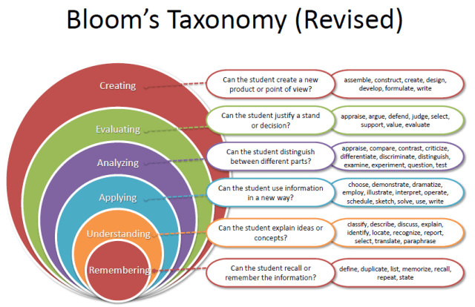
Revised Bloom’s Taxonomy

Slide 10
Program Outcomes
PO1 : Engineering Knowledge : Apply knowledge of mathematics, natural science, computing, engineering fundamentals and an engineering specialization as specified in WK1 to WK4 respectively to develop to the solution of complex engineering problems.
PO2 : Problem Analysis : Identify, formulate, review research literature and analyze complex engineering problems reaching substantiated conclusions with consideration for sustainable development. (WK1 to WK4)
PO3 : Design/Development of Solutions : Design creative solutions for complex engineering problems and design/develop systems/components/processes to meet identified needs with consideration for the public health and safety, whole-life cost, net zero carbon, culture, society and environment as required. (WK5)
PO4 : Conduct Investigations of Complex Problems : Conduct investigations of complex engineering problems using research-based knowledge including design of experiments, modelling, analysis & interpretation of data to provide valid conclusions. (WK8).
PO5 : Engineering Tool Usage : Create, select and apply appropriate techniques, resources and modern engineering & IT tools, including prediction and modelling recognizing their limitations to solve complex engineering problems. (WK2 and WK6)
PO6 : The Engineer and The World : Analyze and evaluate societal and environmental aspects while solving complex engineering problems for its impact on sustainability with reference to economy, health, safety, legal framework, culture and environment. (WK1, WK5, and WK7).

Slide 11
Program Outcomes
PO7 : Ethics : Apply ethical principles and commit to professional ethics, human values, diversity and inclusion; adhere to national & international laws. (WK9)
PO8 : Individual and Collaborative Team work : Function effectively as an individual, and as a member or leader in diverse/multi-disciplinary teams.
PO9 : Communication : Communicate effectively and inclusively within the engineering community and society at large, such as being able to comprehend and write effective reports and design documentation, make effective presentations considering cultural, language, and learning differences
PO10 : Project Management and Finance : Apply knowledge and understanding of engineering management principles and economic decision-making and apply these to one’s own work, as a member and leader in a team, and to manage projects and in multidisciplinary environments.
PO11 : Life-Long Learning : Recognize the need for, and have the preparation and ability for i) independent and life-long learning ii) adaptability to new and emerging technologies and iii) critical thinking in the broadest context of technological change. (WK8)

Slide 12
Program Specific Outcomes
PSO1 : Apply acquired skills in software engineering, networking, security, databases, intelligent systems, cloud computing and operating systems to adapt and deploy innovative software solutions for diverse applications.
PSO2 : Apply diverse IT skills to design, develop, and evaluate innovative solutions for business environments, considering risks, and utilizing interdisciplinary knowledge for efficient real-time projects benefiting society.

Slide 13
Course Outcomes
CO1 :: understand the basics of data preprocessing and exploratory data analysis
CO2 :: apply regression techniques and evaluate regression model performance
CO3 :: apply classification algorithms and assess their performance
CO4 :: analyze clustering algorithms and association rule mining in unsupervised learning
CO5 :: understand and implement foundational neural network models
CO6 :: evaluate model performance and apply various methods to enhance predictive accuracy

Slide 14

What is Predictive Analytics?

Slide 15
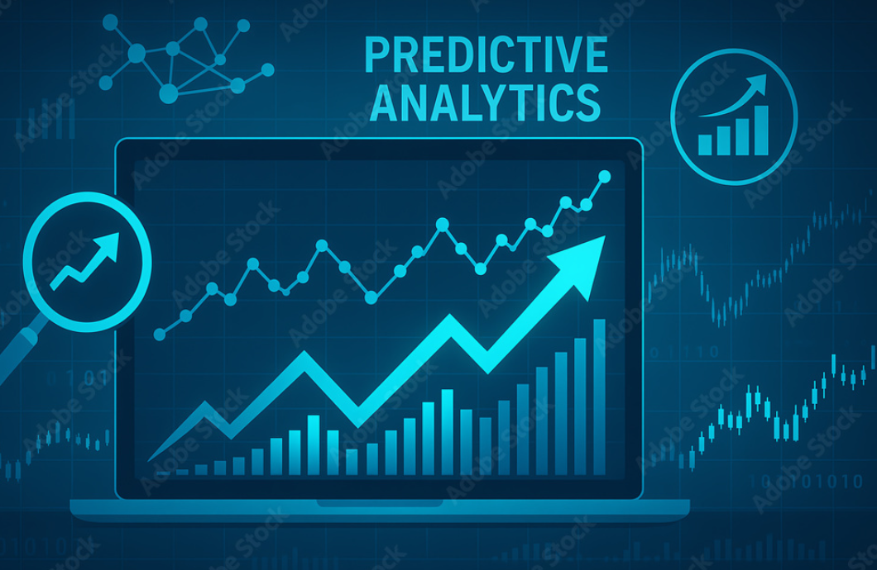
Predictive Analytics
Uses statistical & machine learning techniques
Analyzes current and historical data
Predicts possible future outcomes
Identifies trends and data patterns
Helps in informed decision-making
Supports business planning
Notes:
Analytics is the process of discovering, interpreting, and communicating significant patterns in data. . Quite simply, analytics helps us see insights and meaningful data that we might not otherwise detect.
analysis deals with events that have already happened, while analytics steps on past and current data, and is primarily forward-looking.

Slide 16

Importance of Predictive Analytics
Organizations hold vast historical data
Data reveals useful hidden trends
Models built from historical patterns
Applied to current data sets
Predicts future behaviors or events
Increases efficiency & profitability

Slide 17
Why Predictive Analytics?
High demand across all industries
Drives data-informed decision-making
Offers competitive business advantage
Optimizes processes and resources
Enhances customer understanding and experience
Enables future-ready organizations

Slide 18
A Valuable Skillset
Uses historical data and models
Applies statistical and AI techniques
Identifies trends and patterns clearly
Predicts future events with accuracy
Supports smarter strategic business planning
Increases employability and job prospects

Slide 19
Course Content
Unit I
Introduction and Data Preparation : Introduction to Predictive Analytics, machine learning and its types, supervised and unsupervised learning, data preprocessing
Unit II
SUPERVISED LEARNING: REGRESSION : Simple Linear Regression, Multiple Linear Regression, Polynomial Regression, Logistic Regression, Ordinary Least Squares Estimation, Correlations, Evaluate Model Performance: Mean Absolute Error (MAE), Mean Squared Error (MSE), R-squared (R²) Score, Root Mean Squared Error (RMSE)
Unit III
SUPERVISED LEARNING: CLASSIFICATION : Lazy learning:Nearest neighbors, Naïve Bayes, Divide and Conquer: Decision Trees and Rules, Support vector machine, Evaluate Model Performance: Accuracy, Logarithmic Loss, Area Under Curve, Precision, Recall, F1 Score, Confusion Matrix

Slide 20
Unit IV
UNSUPERVISED LEARNING: CLUSTERING AND PATTERN DETECTION : K-Means Clustering, K means clustering intuition, K-means random initialization trap, K-means selecting number of clusters, Hierarchical Clustering (Divisive, Agglomerative), Types of Linkages (Single, Complete, Average, Centroid), Association Rules, Finding Patterns, Market Basket Analysis Using Association Rules
Unit V
Dimensionality Reduction and Neural Networks : Dimensionality Reduction, Principal Component Analysis (PCA), Feedforward Neural Networks, Multi-layer Perceptron (MLP), Convolutional Neural Networks, Recurrent Neural Networks
Unit VI
MODEL PERFORMANCE : Bias-variance trade-off, Cross-validation methods:Leave-one-out (LOO) cross-validation, K-folds cross-validation, Bagging, Boosting, Random forests

Slide 21
ICT Tools Used: Python (with libraries like scikit-learn, pandas, matplotlib, seaborn,etc)
Practical Application Slides (Unit-wise Examples)
Unit 1: Preprocessing on e-commerce customer data
Unit 2: Regression modeling for sales forecasting
Unit 3: Classification models for credit scoring / loan approval
Unit 4: Customer segmentation using clustering and association rule mining for retail
Unit 5: Dimensionality reduction and basic neural networks on stock data
Unit 6: Model validation, boosting models (for churn prediction)

Slide 22
OER
Unit mapped | Broad topic | Source Type | Source Title | *%age mapping (approx) | Source URL
Unit 1 | Introduction to Predictive Analytics, ML types, Data Preprocessing | Documentation | Scikit-learn: Getting Started and Data Preprocessing | 100% | https://scikit-learn.org/stable/getting_started.html
Unit 2 | Regression Techniques and Evaluation | Documentation | Regression Models in scikit-learn | 100% | https://scikit-learn.org/stable/supervised_learning.html

Slide 23
Unit 3 | Classification Algorithms & Evaluation | Interactive Course + Docs | Google Developers – Classification Concepts | 100% | https://scikit-learn.org/stable/supervised_learning.html
Unit 4 | Clustering and Association Rules | Documentation | Clustering (scikit-learn) + Association Rules (MLxtend) | 100% | https://scikit-learn.org/stable/modules/clustering.html | https://rasbt.github.io/mlxtend/user_guide/frequent_patterns/association_rules/

Slide 24
Unit 5 | Dimensionality Reduction and Neural Networks | Documentation + Guide | PCA in scikit-learn + TensorFlow NN Tutorials | 100% | https://scikit-learn.org/stable/modules/decomposition.html#pca | https://www.geeksforgeeks.org/machine-learning/neural-networks-a-beginners-guide/
Unit 6 | Model Evaluation, Cross Validation, Ensemble Methods | Documentation | Model Evaluation and Ensemble Methods in scikit-learn | 90% | https://scikit-learn.org/stable/modules/model_evaluation.html, https://scikit-learn.org/stable/modules/ensemble.html

Slide 25
EduRev Initiatives
students can access and participate through the Edu-Revolution interface:
UMS Navigation → LMS > Edu-Revolution: Be the Change
Category -Recognition of Prior Learning (RPL)
Application
Students who have applied statistics, Python programming, and machine learning techniques during their internship experience will be considered for RPL
Students who have successfully completed any proctored certification or NPTEL course relevant to statistics, Python programming, or machine learning will be considered for RPL
Students who have secured an A+ grade or higher in the course ‘Data Science Toolbox: Python Programming (INT375)’ during the previous semester will be considered for RPL

Slide 26
Category-NPTEL/MOOCs/Certification
NPTEl/MOOCS | Agency | WebURL
Introduction to Machine Learning, IIT Kharagpur Prof. S. Sarkar | NPTEL | https://nptel.ac.in/courses/106105152
Introduction to Machine Learning, IIT Madras Dr. Balaraman Ravindran | NPTEL | https://nptel.ac.in/courses/106106139
Google Professional Machine Learning Engineer | Google Cloud | https://cloud.google.com/learn/certification/machine-learning-engineer
AWS Certified Machine Learning | Offered by Amazon Web Services (AWS) | https://aws.amazon.com/certification/certified-machine-learning-specialty/

Slide 27
Category Projects
Title of Project | Source | WebURL
Geo Data Anaytics, Research& Modeling (AI, ML, IoT, Data Science & Analytics) Group (GRAM) | Punjab Remote Sensing Centre | https://prsc.punjab.gov.in/
primary data gathered from any govt or well established Pvt companies CMM level 2 or above and predictive modelling onsite of the source body | Any government agencies or well established Pvt companies CMM level 2 | https://www.sih.gov.in/
AI-Driven Crop Disease Prediction and Management System with revenue of minimum 50K | Smart India Hackathon | https://www.sih.gov.in/sih2024PS
Downscaling of Satellite based air quality map using AI/ML with revenue of minimum 50K | Smart India Hackathon | https://www.sih.gov.in/sih2024PS
Development of AI/ML based solution for detection of face-swap based deep fake videos with revenue of minimum 50K | Smart India Hackathon | https://www.sih.gov.in/sih2024PS
Dynamic route rationalization model based on ML/AI is required based on real-time traffic and road parameters with revenue of minimum 50K | Smart India Hackathon | https://www.sih.gov.in/sih2024PS
Intelligent platform to Interconnect Alumni and Student for Technical Education Department, Govt. of Rajasthan with revenue of minimum 50K | Smart India Hackathon | https://www.sih.gov.in/sih2024PS

Slide 28
Category-Grade Upgradation (Core)
Description
Winners of HackIndia 2025
Paper publication in Q1 SCI/Scopus Journals (Elsevier, IEEE, Springer)
Winners of Smart India Hackathon (SIH) 2025

Slide 29
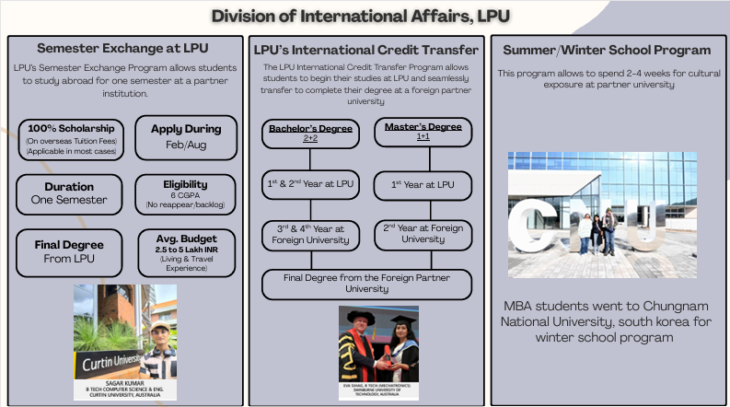
International Opportunities

Slide 30
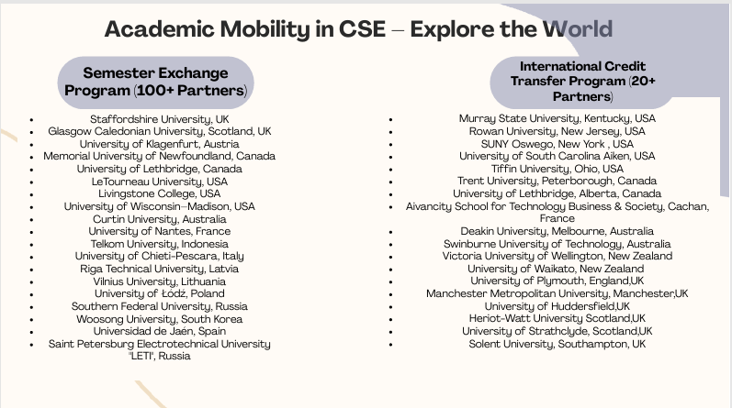

Slide 31


Slide 32
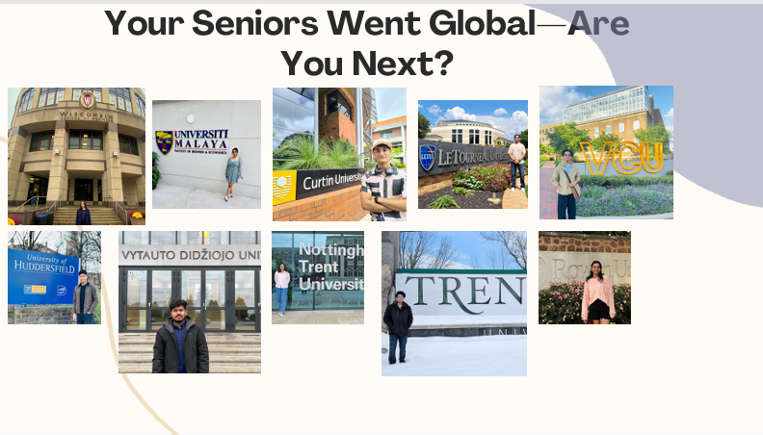

Slide 33
Next Class: Installation of Software

